Slide 1
Simple Linear Regression in Machine Learning
Predicting the future with a straight line

Slide 2
What is Simple Linear Regression?
Supervised Learning
Models the relationship between one independent variable (input) and one dependent variable (output)
Linear Relationship
Assumes as the input changes, the output changes at a constant rate
Real-World Example
Predicting a student's exam score based on hours studied

Slide 3
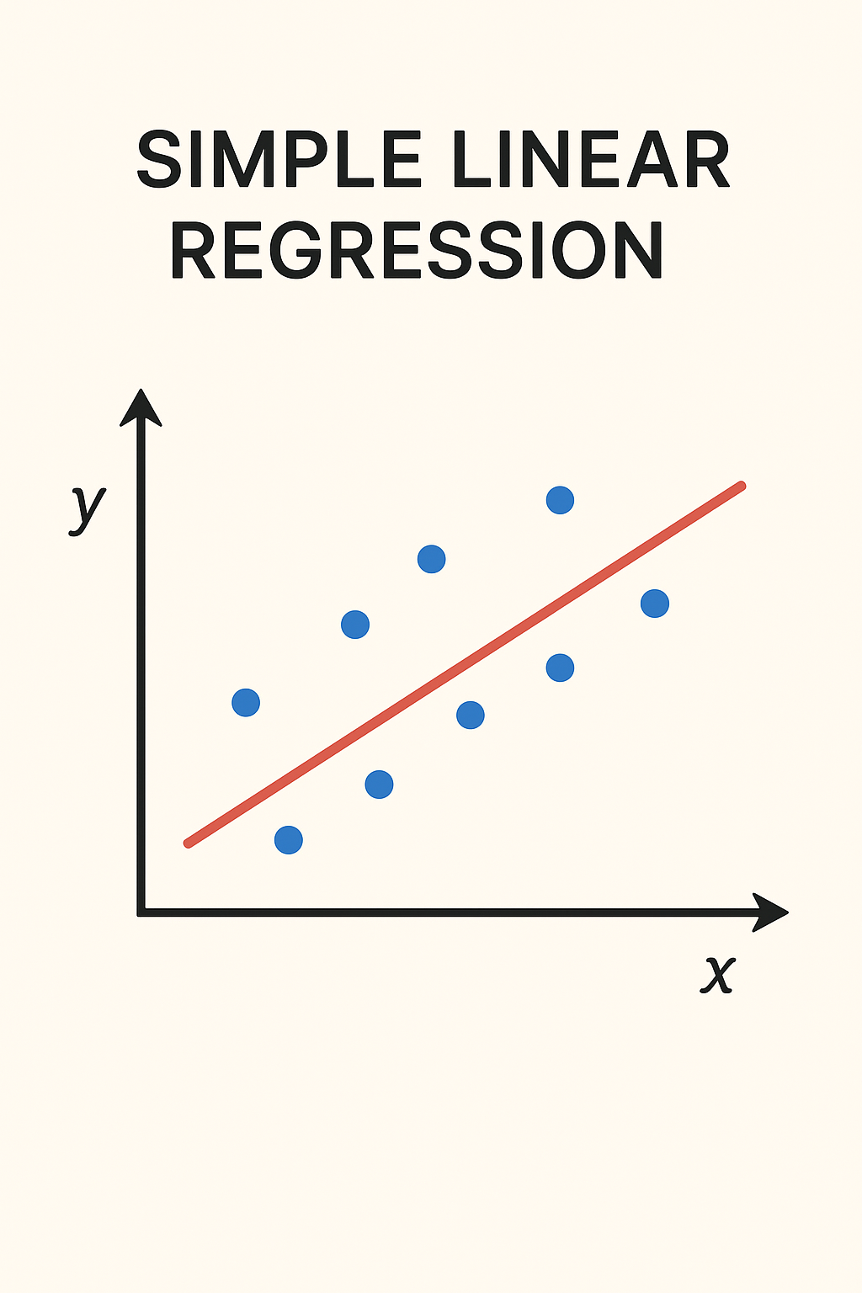
Simple Linear Regression is a basic yet powerful statistical technique used to understand and predict the relationship between two variables — one independent variable (x) and one dependent variable (y).
In simple terms, it tries to draw the best straight line through a set of data points on a graph, showing how one variable affects the other.

Slide 4
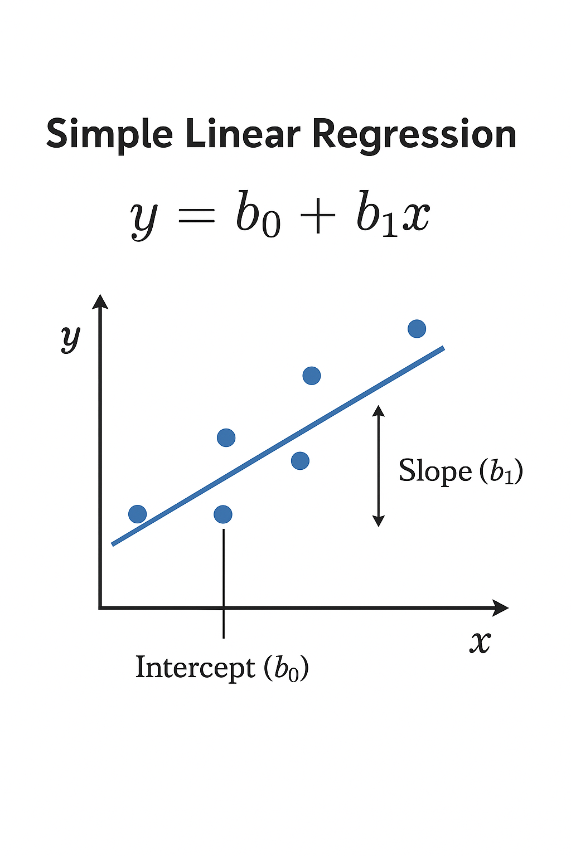

Simple Linear Regression Equation in Machine Learning
Model Formula
$$y=b_{0}+b_{1}x$$
Where:
Predicted value (e.g., exam score)
y represents the output predicted by our model
Independent variable (e.g., hours studied)
X is the feature we use for prediction
b₀ → Intercept (the value of y when x = 0)
It is intercept or bias term
b₁ → Slope (how much y changes for each unit increase in x)
It is slope or weight parameter

Slide 5
Why Simple Linear Regression Matters
Simple Linear Regression introduces the core ideas of supervised learning — using input data (x) to predict an output (y) based on patterns. It teaches key concepts like:
Training data
Model fitting
Prediction
Error minimization
Evaluation metrics (like MSE – Mean Squared Error)
These ideas reappear in almost every machine learning algorithm.

Slide 6
Simplicity & Interpretability
Easy to understand and explain to both technical and non-technical audiences
It provides a clear, mathematical relationship between variables that’s easy to understand and visualize.
The slope (b₁) shows how much the output changes for each unit increase in input.
The intercept (b₀) shows the baseline prediction when input is zero. This interpretability helps analysts explain models to non-technical audiences — which is crucial in fields like finance, business, and healthcare.

Slide 7
Foundation for Complex Models
Serves as the basis for logistic regression, neural networks, and advanced algorithms
Many advanced algorithms (like Multiple Linear Regression, Logistic Regression, Polynomial Regression, and even Neural Networks) build upon the same principles as Simple Linear Regression:
Learning weights (or coefficients)
Reducing error using optimization techniques
Making predictions on unseen data
Understanding linear regression helps in grasping how these more complex models work internally.

Slide 8
Predictive Power
It allows for making forecasts about future outcomes based on past data. For example, predicting sales based on advertising spend or estimating housing prices based on square footage.
Accurately forecasts outcomes based on historical data patterns
Efficiency
Fast computation and highly effective for linear relationships
Linear regression models are computationally efficient and can be trained quickly, even on large datasets.

Slide 9
Data-driven decision-making:
By transforming large datasets into actionable information, it helps businesses and organizations make better decisions instead of relying solely on intuition or experience.
Variable significance:
It helps identify which independent variables have a significant impact on the outcome variable.
Analytical insights:
It reveals how much one variable is expected to change as another variable increases, providing valuable analytical insights into the relationship between them.

Slide 10

The Best-Fit Line: The Heart of Linear Regression
In Simple Linear Regression, the best-fit line (also called the regression line) is the straight line that passes through the data points such that the difference between actual and predicted values is as small as possible.
Mathematically, it’s represented as:
$$y=b_{0}+b_{1}x$$
Where:
y → predicted value (output)
x → input feature
b₀ → intercept (value of y when x = 0)
b₁ → slope (how much y changes when x increases by 1 unit)

Slide 11
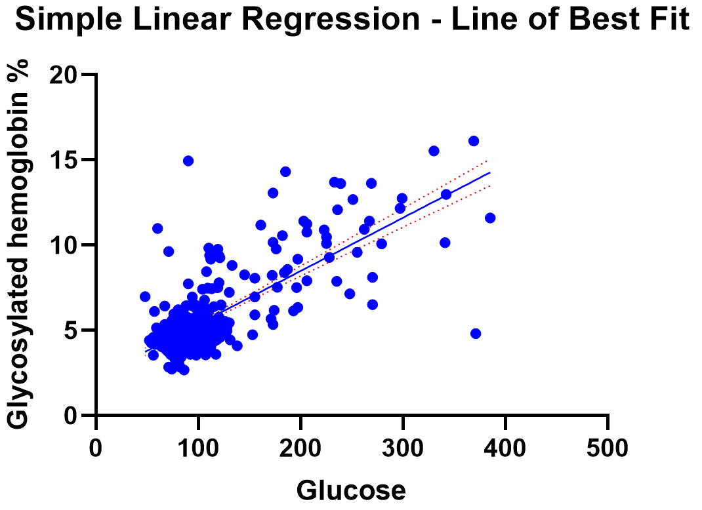
Example:

Slide 12
Minimizing Error: The Least Squares Method
Minimizing Error: The Least Squares Method is one of the most important ideas behind Simple Linear Regression and machine learning in general. It’s the process that allows us to find the best-fit line mathematically.
The Least Squares Method
The Least Squares Method is a mathematical technique used to find the best-fitting line through a set of data points by minimizing the sum of the squares of the errors (residuals) between the observed values and the values predicted by the line.

Slide 13

Understanding “Error” or “Residual”
For each data point in your dataset, you have:
Actual value (yᵢ) — what you observe from data
Predicted value (ŷᵢ) — what your regression line estimates
The error (or residual) for each point is:
$$e_{i}=y_{i}−\hat{y_{i}}$$
If the model predicts perfectly, this error would be zero. But in real data, there are always some differences — the Least Squares Method tries to make these differences collectively as small as possible.
Calculate Residuals
Measure differences between actual and predicted values for each data point

Slide 14
Square the Errors
Square each residual to eliminate negative values and emphasize larger errors
Why “Squares”?
We square the errors instead of just summing them for two key reasons:
To remove negative signs — since some points lie above and some below the line.
To penalize large errors more heavily — squaring makes large deviations count more, leading to a more accurate fit overall.
So the total squared error (also called the Sum of Squared Errors, SSE) is:
SSE=∑(yi​−yi​^​)2

Slide 15

Minimize the Sum
Find the line that minimizes the sum of squared residuals for optimal fit
The objective is to find the slope (b₁) and intercept (b₀) that minimize this SSE:
Minimize SSE=∑(yi​−(b0​+b1​xi​))2
By using calculus (taking partial derivatives and setting them to zero), we derive formulas for the optimal coefficients:
$$\text{b}\text{1​}\text{=}\text{∑}\text{(}\text{xi}\text{​}\text{−}\text{x}\text{ˉ)}\text{2}\text{∑}\text{(}\text{xi}\text{​}\text{−}\text{x}\text{ˉ)(}\text{yi}\text{​}\text{−}\text{y}\text{ˉ​)​ }$$
$$b_{0}=\overset{ˉ}{y}−b_{1}\overset{ˉ}{x}$$
These values ensure the line fits the data with the smallest total squared deviation.

Slide 16
Assumptions Behind Simple Linear Regression
For simple linear regression to work effectively, several key assumptions must hold true:
Linearity
The relationship between X and Y must be linear- a straight line can model it
The relationship between X and Y must be linear.
This means:
Y=β0​+β1​X+ϵ
where ϵ is the random error.
Interpretation: Changes in X lead to proportional changes in Y.
Check: Use a scatter plot of X vs. Y — it should show a roughly straight-line pattern.

Slide 17
Independence
Observations are independent of each other; one data point doesn't influence another
The residuals (errors) should be independent of each other.
There should be no autocorrelation (especially in time series data).
Check: Plot residuals vs. time or use the Durbin–Watson test.
Homoscedasticity (Constant Variance of Errors)
The variance of residuals remains constant across all levels of the independent variable
The variance of residuals should be constant across all levels of X.
If not, the data suffers from heteroscedasticity.
Check: Plot residuals vs. fitted values — the spread should be uniform (no funnel shape).

Slide 18
Normality
Residuals follow a normal distribution (especially important for statistical inference)
The residuals (errors) should follow a normal distribution.
This assumption is important for hypothesis testing (e.g., t-tests, F-tests).
Check: Use a histogram or Q-Q plot of residuals — they should look approximately normal.
No or Minimal Measurement Error in X
The independent variable X should be measured accurately.
Measurement errors in X can lead to biased estimates of the regression coefficients.

Slide 19
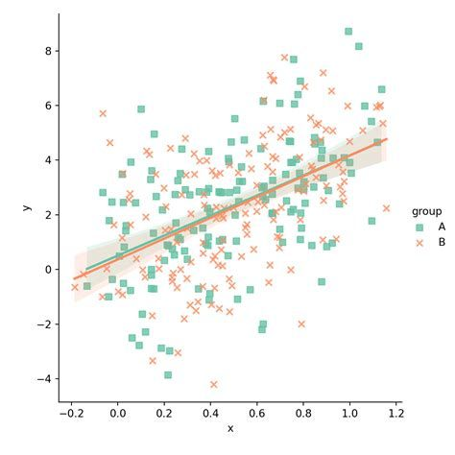
Visualizing Simple Linear Regression
Key Visual Elements
Scatter plot shows individual data points
Green line represents the best-fit regression
Slope indicates rate of change
Intercept shows starting value
The visualization demonstrates how predicted values align closely with actual data, providing intuitive understanding of the model's performance.

Slide 20
Implementing Simple Linear Regression in Python
Import Libraries
Load sklearn’s Linear Regression and necessary dependencies
Prepare Your Data
Organize features (X) and target variable (y) into proper format
Train the Model
Fit the linear regression model to your training data
Make Predictions
Use the trained model to predict outcomes on new data

Slide 21
Example :
from sklearn.linear_model import LinearRegression
# Create and train model
model = LinearRegression()
model.fit(X_train, y_train)
# Make predictions
predictions = model.predict(X_test)

Slide 22

What is R-squared (R²)?
R-squared, also called the coefficient of determination, measures how much of the variance in the dependent variable (Y) is explained by the independent variable (X) in the model.
It tells us how well the regression line fits the data.
Formula
$$R^{2}=1−\frac{SS_{res}}{SS_{tot}}$$
Where:
$SS_{res}$= Sum of squares of residuals =
$SS_{tot}$= Total sum of squares = ∑(yi​−yˉ​)2
∑(yi​−yi​^​)2

Slide 23
Interpretation
R² Value | Interpretation
0 | Model explains none of the variance in Y
0.5 | Model explains 50% of the variance in Y
1 | Model explains all the variance perfectly
So, higher R² = better fit, but not always perfect (sometimes too high R² means overfitting).

Slide 24

Example
Suppose:
$SS_{res}=100$
$SS_{tot}=400$
Then:
$$R^{2}=1−\frac{100}{400}=0.75$$
This means 75% of the variation in Y is explained by X. The remaining 25% is due to random error or other variables not included in the model.

Slide 25
Strengths of Linear Regression Regression
Strength | Explanation
1. Simple and Easy to Implement | It’s one of the easiest algorithms to understand, interpret, and implement. Just a straight-line relationship between variables.
2. Computationally Efficient | Training a linear regression model is fast and requires little computational power — great for large datasets.
3. Interpretable Results | The coefficients directly show how much the dependent variable changes when the independent variable increases by one unit.
4. Works Well with Linearly Related Data | If the relationship between X and Y is approximately linear, it performs extremely well.
5. Foundation for More Complex Models | It’s the building block for many advanced models like Ridge, Lasso, and Polynomial Regression.
6. Provides Analytical Insight | Gives a clear mathematical equation for prediction, making it easy to explain to non-technical stakeholders.

Slide 26
Weaknesses of Linear Regression
Weakness | Explanation
1. Assumes Linearity | It only captures linear relationships. Non-linear data cannot be modeled accurately.
2. Sensitive to Outliers | A few extreme values can distort the regression line heavily.
3. Requires Assumptions to Hold | Assumptions like normality, homoscedasticity, and independence of errors must be met — otherwise, results become unreliable.
4. Poor with Multicollinearity (in Multiple Regression) | If predictors are highly correlated, coefficient estimates become unstable.
5. Doesn’t Handle Complex Relationships | Real-world data often have non-linear patterns or interactions — linear regression can’t capture those.
6. May Overfit or Underfit | Especially with small or noisy datasets, the model may not generalize well.

Slide 27
Summary Table
Category | Details
Best for | When the relationship between variables is approximately linear and assumptions are satisfied.
Avoid when | Data is non-linear, has many outliers, or violates regression assumptions.

Slide 28
Linear Regression is one of the most widely used algorithms in both business and research because it’s simple, interpretable, and effective when relationships are approximately linear.
Let’s explore its main use cases across different domains
Real Estate
Use Case | Description
House Price Prediction | Predicting property prices using features like location, area, number of rooms, etc.
Rent Estimation | Estimating monthly rent based on area and amenities.

Slide 29
Business & Economics
Use Case | Description
Sales Forecasting | Predicting future sales based on advertising spend, price, or time. Example: estimating how much revenue will increase if marketing budget rises.
Price Estimation | Used to determine pricing models (e.g., predicting house prices or car prices based on features).
Demand & Supply Analysis | Understanding how product demand changes with price or income.
Market Trend Analysis | Forecasting economic indicators like GDP growth, inflation, or unemployment rates.

Slide 30
Healthcare
Use Case | Description
Predicting Disease Progression | Estimating disease severity (e.g., blood sugar level prediction based on BMI, age, and diet).
Healthcare Cost Estimation | Predicting hospital bills or insurance costs based on patient data.
Finance
Use Case | Description
Stock Market Prediction (Basic) | Predicting stock prices or returns based on past trends and features.
Risk Management | Modeling credit risk or loan default probabilities.
Investment Forecasting | Predicting returns on investment over time.

Slide 31
Manufacturing & Industry
Use Case | Description
Quality Control | Predicting defects or performance based on process variables.
Production Optimization | Estimating output based on resource input (like labor hours, material usage).
Education
Use Case | Description
Student Performance Prediction | Estimating exam scores based on study hours, attendance, or assignments.
Dropout Risk Analysis | Predicting the likelihood of a student leaving school early.

Slide 32
Environment & Agriculture
Use Case | Description
Weather Forecasting (Basic) | Estimating temperature or rainfall based on historical data.
Crop Yield Prediction | Predicting yield based on rainfall, soil quality, and fertilizer use.
Marketing & Customer Analytics
Use Case | Description
Customer Lifetime Value (CLV) | Predicting how much revenue a customer will generate.
Ad Performance Prediction | Estimating how ad spend affects clicks or conversions.

